Slide 1
INAPPROPRIATE EXPRESSIONS RECOGNITION USING BOOTSTRAPPING AS SEMI-SUPERVISED LEARNING
BSCS 4-2
MEMBERS:
DAPITAN, JOSHUA S.
LASALA, ANJANETTE R.

Slide 2
RECAP
Inappropriate expressions becomes very interesting in the field of natural language processing.
Inappropriate expressions mostly causes problems in literary management like cyber bullying and exposure of children to other textual data.
The problems that need to be solved are the following:
Inherent ambiguity of the language
Accuracy of the system

Slide 3
RECAP
Semi-supervised learning methods are proposed to effectively utilize a small scale of labeled data along with a larger amount of unlabeled data.
Bootstrapping is not a sample size dependent resampling schema. Increasing the number of samples cannot increase the amount of information in the original data, it can only reduce the effects of random sampling errors which can arise from a bootstrap procedure itself.
Detection of Harassment on Web 2.0 uses a baseline text mining system (using bag of words approach) and utilizes sentiment and contextual features using Support Vectors. It is somewhat limited due to the bag of words approach may not model the context.
Detecting Offensive Language in Social Media to Protect Adolescent Online Safety uses Lexical Syntactic Features and Derives the Offensive Value based on those features. It is has a limitation on Knowledge base due to it has no learning.
Detecting Offensive Tweets via Topical Feature Discovery via statistical topic modeling based on tweets with a seed words, which will be limited on the word itself and the topic related.
Filtering Offensive Language in Online Communities using Grammatical Relations uses Part-of-speech tags and collection of offensive words. Words that are not in the lexicon are considered inoffensive, which is limited implementation.

Slide 4


Slide 5


Slide 6
Statement of the problem
The study aims to design, develop and evaluate the system which will help to recognize Inappropriate Expressions from a document. The people who are in knowledgeable in English language are the respondents in this study. In addition to this, the researchers aim to seek answer to this problem:
What is the performance analysis of the model in terms of:
1. Recognition of Inappropriate expressions. (Accuracy of the Model)
2. Recognition of Appropriate expressions. (Specificity of the Model)

Slide 7
Scope and limitations of the system
The system will accept an English comment as an input.
Underscores, slashes symbols, lexical distortions and multiple word Expressions are to be avoided as an input.
The analysis will be based on the phrase level orientation based on the output of the n-gram model which is 2-5 gram N-Gram Model.
domain for the recognition of inappropriateness:
offensive and
sexually Explicit Language

Slide 8
Scope and limitations of the study
The system will be evaluated by an expert, which is an English Teacher.
The inputs will be documents and text file.

Slide 9
System architecture
Learning Module for InappEx Recognition
Inappropriate Expressions Collection
Inappropriate Expression Feature Extractor
Collection of Inappropriate Expression Feature
Synset Resampler
Dictionary
Sentiment Corpus
Exception List

Slide 10
Collection of Inappropriate Expression Feature
Learning Module for InappExpr Patterns
Inappropriate Expressions Searching
N-Gram Generation
N-Gram Collection
Training Comment
Exception List
Notes:
Inappropriate Expressions Candidation – mark IE
2-5 grams

Slide 11
A
N
A
L
Y
Z
E
R
F
O
R
I
N
A
P
P
R
O
P
R
I
A
T
E
E
X
P
R
S
P
Preprocessing
Input
Sentence Splitter
Inappropriate Expressions Searching
N-Gram Collection
Tokenizer
N-Gram Parser
POS Tagger
Relational Inference Analyzer
Inappropriate Expressions in the Input
Stemmer
Entity Tagger

Slide 12
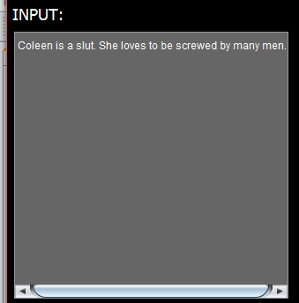

Slide 13
A
N
A
L
Y
Z
E
R
F
O
R
I
N
A
P
P
R
O
P
R
I
A
T
E
E
X
P
R
S
P
Preprocessing
Input
Sentence Splitter
Inappropriate Expressions Candidation
N-Gram Collection
Tokenizer
N-Gram Parser
POS Tagger
Relational Inference Analyzer
Inappropriate Expressions in the Input
Stemmer
Entity Tagger

Slide 14
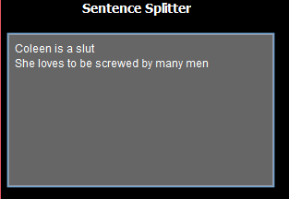

Slide 15
A
N
A
L
Y
Z
E
R
F
O
R
I
N
A
P
P
R
O
P
R
I
A
T
E
E
X
P
R
S
P
Preprocessing
Input
Sentence Splitter
Inappropriate Expressions Candidation
N-Gram Collection
Tokenizer
N-Gram Parser
POS Tagger
Relational Inference Analyzer
Inappropriate Expressions in the Input
Stemmer
Entity Tagger

Slide 16
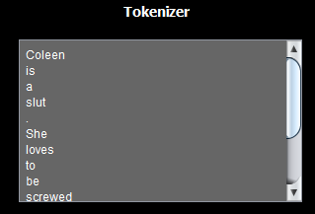

Slide 17
A
N
A
L
Y
Z
E
R
F
O
R
I
N
A
P
P
R
O
P
R
I
A
T
E
E
X
P
R
S
P
Preprocessing
Input
Sentence Splitter
N-Gram Collection
Inappropriate Expressions Candidation
Tokenizer
N-Gram Parser
POS Tagger
Relational Inference Analyzer
Inappropriate Expressions in the Input
Stemmer
Entity Tagger

Slide 18
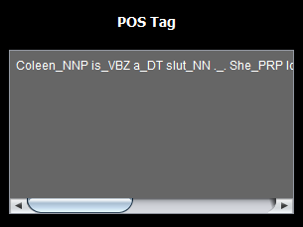

Slide 19
A
N
A
L
Y
Z
E
R
F
O
R
I
N
A
P
P
R
O
P
R
I
A
T
E
E
X
P
R
S
P
Preprocessing
Input
Sentence Splitter
Inappropriate Expressions Candidation
N-Gram Collection
Tokenizer
N-Gram Parser
POS Tagger
Relational Inference Analyzer
Inappropriate Expressions in the Input
Stemmer
Entity Tagger

Slide 20

Notes:
rootword

Slide 21
A
N
A
L
Y
Z
E
R
F
O
R
I
N
A
P
P
R
O
P
R
I
A
T
E
E
X
P
R
S
P
Preprocessing
Input
Sentence Splitter
Inappropriate Expressions Candidation
N-Gram Collection
Tokenizer
N-Gram Parser
POS Tagger
Relational Inference Analyzer
Inappropriate Expressions in the Input
Stemmer
Entity Tagger

Slide 23
A
N
A
L
Y
Z
E
R
F
O
R
I
N
A
P
P
R
O
P
R
I
A
T
E
E
X
P
R
S
P
Preprocessing
Input
Sentence Splitter
Inappropriate Expressions Candidation
N-Gram Collection
Tokenizer
N-Gram Parser
POS Tagger
Relational Inference Analyzer
Inappropriate Expressions in the Input
Stemmer
Entity Tagger

Slide 24
A
N
A
L
Y
Z
E
R
F
O
R
I
N
A
P
P
R
O
P
R
I
A
T
E
E
X
P
R
S
P
Preprocessing
Input
Sentence Splitter
Inappropriate Expressions Candidation
N-Gram Collection
Tokenizer
N-Gram Parser
POS Tagger
Relational Inference Analyzer
Inappropriate Expressions in the Input
Stemmer
Entity Tagger

Slide 25


Slide 26
A
N
A
L
Y
Z
E
R
F
O
R
I
N
A
P
P
R
O
P
R
I
A
T
E
E
X
P
R
S
P
Preprocessing
Input
Sentence Splitter
Inappropriate Expressions Candidation
N-Gram Collection
Tokenizer
N-Gram Parser
POS Tagger
Relational Inference Analyzer
Inappropriate Expressions in the Input
Stemmer
Entity Tagger

Slide 27


Slide 28
A
N
A
L
Y
Z
E
R
F
O
R
I
N
A
P
P
R
O
P
R
I
A
T
E
E
X
P
R
S
P
Preprocessing
Input
Sentence Splitter
N-Gram Collection
Inappropriate Expressions Candidation
Tokenizer
N-Gram Parser
POS Tagger
Relational Inference Analyzer
Inappropriate Expressions in the Input
Stemmer
Entity Tagger

Slide 29
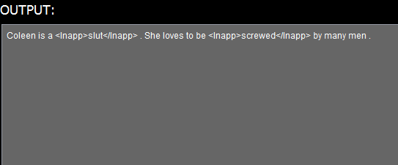

Slide 30
Relational Inference Analyzer
Expression Chains with Inappropriate Expressions
Bag of Words Model for Inappropriate Expressions
Hidden Markov Model for InappExprs referencing
Inappropriateness

Slide 31
Sample size
Sample size is an important concept in statistics and refers to the number of individual pieces of data collected. A statistic’s sample size is important in determining the accuracy and reliability of the system.
In contrast to other researches which is most likely used people as their population, this study focused on objects as its focus. These objects that were obtained from 9gag and YouTube comments were set by the statistician to 500 due to unknown total population.

Slide 32
Experiment Paper
File No. | No. of Tokens | TP | FP | TN | FN | Precision TP/TP+FP | Recall TP/TP+FN | F-Measure 2PR/P+R | Specificity TN/TN+FP
1
2
3
4
5
Total
Average
Software Evaluation Tool

Slide 33
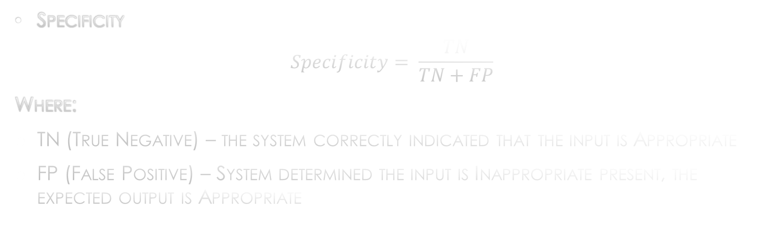
Statistical treatment
Specificity
$$Specificity= \frac{TN}{TN+FP}$$
Where:
TN (True Negative) – the system correctly indicated that the input is Appropriate
FP (False Positive) – System determined the input is Inappropriate present, the expected output is Appropriate

Slide 34
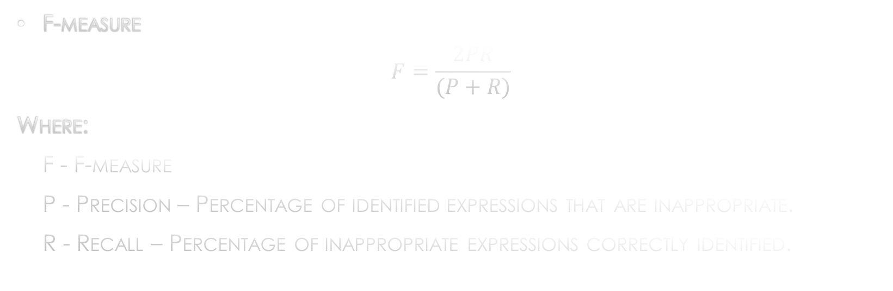
Statistical treatment
F-measure
$$F=\frac{2PR}{(P+R)}$$
Where:
F - F-measure
P - Precision – Percentage of identified expressions that are inappropriate.
R - Recall – Percentage of inappropriate expressions correctly identified.

Slide 35
Results for precision
CLASSIFICATION | TOTAL NUMBER | PRECISION
TP | 389 | 73.12%
FP | 143
Table 1 – Overall Evaluation in terms of Precision

Slide 36
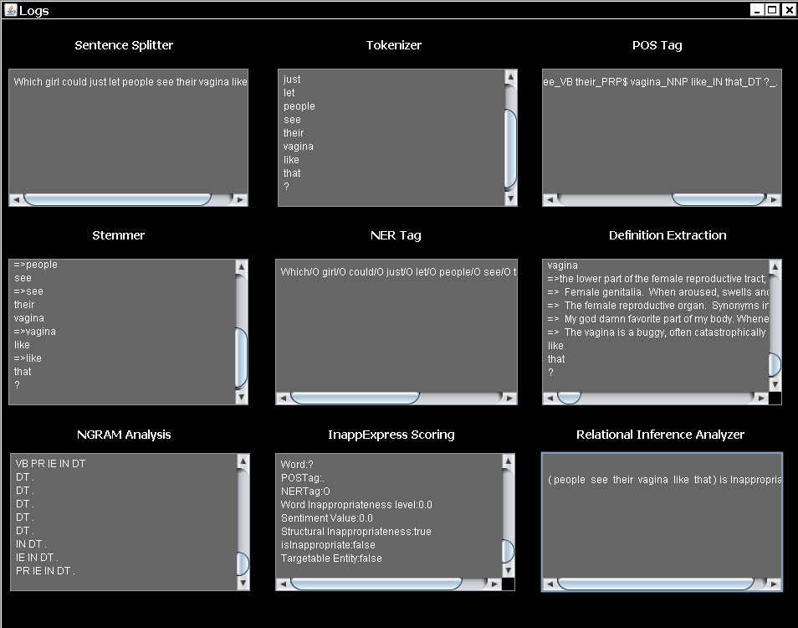
Sample comment with False Positive Result

Slide 37
Results for recall
CLASSIFICATION | TOTAL NUMBER | RECALL
TP | 389 | 66.84%
FN | 193
Table 2 – Overall Evaluation in terms of Recall

Slide 38
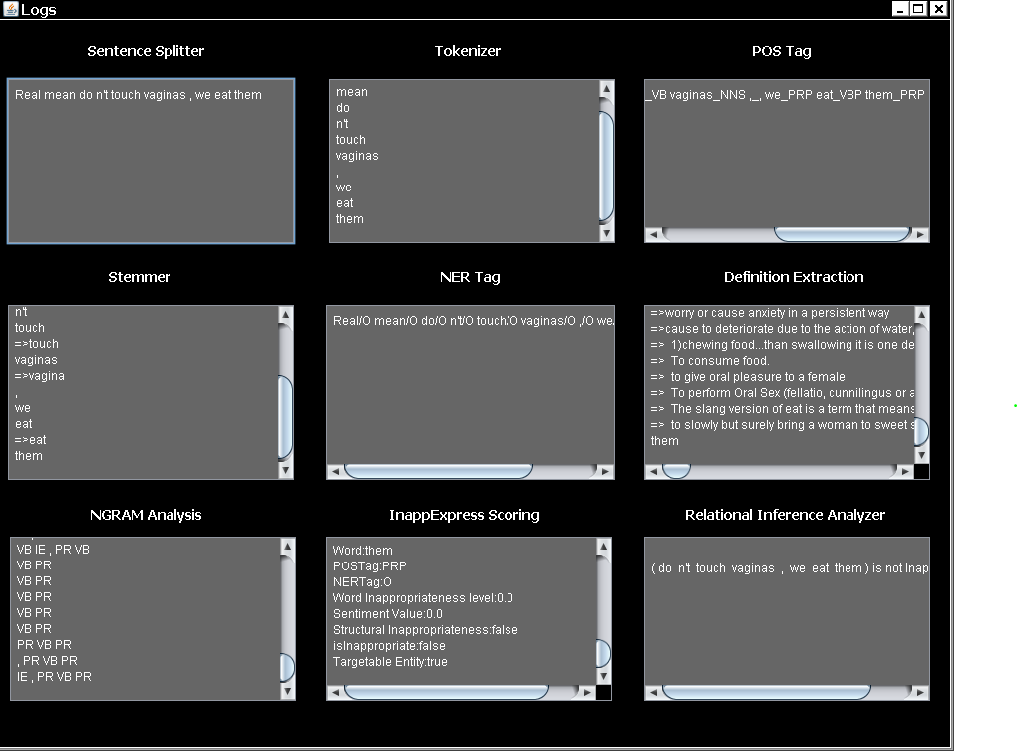
Sample Result with False Negative Result

Slide 39
Results for f-measure
CLASSIFICATION |  |  |  | PRECISION | RECALL | F-MEASURE
TP | FP | TN | FN
389 | 143 | 5662 | 193 | 73.12 | 66.84 | 69.84%
Table 3 – Overall Evaluation in terms of F-Measure

Slide 40
Results for specificity
CLASSIFICATION | TOTAL NUMBER | PRECISION
TN | 5662 | 97.50%
FP | 143
Table 4 – Overall Evaluation in terms of Specificity

Slide 41
conclusion
The overall performance of the developed system in terms of F-Measure is 70% and a Specificity of 98%.
The Exception List has provided a workaround against noisy definitions of UrbanDictionary that causes False Positives.
Bootstrapping has been an effective Semi-Supervised learning schema for Inappropriate Expressions
The performance of the system can be improved if more feature functions were fed into the system.

Slide 42
RECOMMENDATION
Compare the significant difference of the developed inappropriate expressions recognizer that utilizes different algorithm to further emphasize the usefulness of the bootstrapping approach.
The system can be improved by broadening the feature word neighboring to sentence neighboring in order to determine correctly the context of the detected inappropriate expressions.
There is a need for a supervised N-Gram Modeling to model the inappropriate expressions in a proper phrase level scoping.
There should be a control of which UrbanDictionary definitions to be used in avoiding noise of false positives and false negatives.

Slide 43
Recommendation
There is a need for a methodology to handle the noisy definitions of UrbanDictionary to remove the need of an exception list.
There may be a need of usage of other dictionaries like Merriam-Webster’s Dictionary and Oxford Dictionary (Merriam-Webster’s Dictionary and Oxford’s dictionary needs legal permissions before usage).
There may be a need for the recognition of multiple word idiomatic inappropriate expressions.

Slide 44
end

